Slide 1



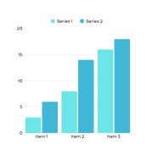
AI Governance Dashboard Mockup
SUMMARY STATS
RISKS
10
Active
AI Systems
7
Ongoing
Projects
2
Incidents
Last Quarter
Algorithmic Bias
Mitigating
Lack of explainability
Transferring
Model Drift
Mitigated
INCIDENTS
COMPLIANCE AND AUDIT
78%
AI Systems Compliant
Upcoming - Mar 25
Mar 20
Database Breach
Unresolved
Overdue - Mar 22
Mar 05
Prompt Injection
Investigating
METRICS
78%
AI Models
Reviewed
15
Compliance
Checks Passed
Feb 15
Adversarial attack
Resolved
Jan 17
Ransomware
Resolved

